Slide 1

University Management System
By: Sherif Ashraf

Slide 2
DATABASE Design

Slide 3
1- TABLES:
Students table:
Student_id(PK), First_name, last_name, email, phone_number, street, city, semester, CGPA, Department_id(FK).
Courses Table:
Course_id(PK), course_name, description, credit_hours, semester, department_id(FK).

Slide 4
1- TABLES:
Departments table:
Department_id(PK), Department_name.
Enrollment Table:
Course_id(FK), Student_id(FK), Grade, points, quality_points, department_id(FK).

Slide 5
2- Relationships:
Students and departments:
Cardinality relationship: many-to-one (M:1).
Participation: mandatory – non-mandatory.
Department and courses:
Cardinality relationship: one-to-many (1:M).
Participation: mandatory – mandatory

Slide 6
2- Relationships:
Students and courses:
Cardinality relationship: many-to-Many (M:N).
Participation: mandatory – non-mandatory.

Slide 7
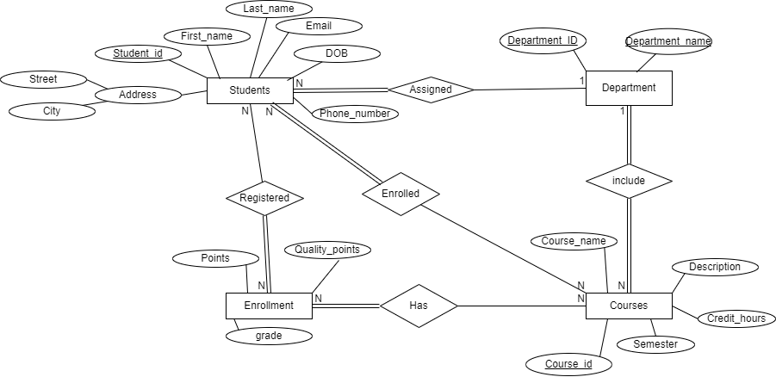
3- ERD Design:

Slide 8
4- Mapping and Normalization:
1. Students (student_id(PK), first_name, last_name, email, phone_number, DOB, Street, City, CGPA, semester, department_id(FK))
2. Departments (Department_id(PK), department_name)
3. Courses (Course_id(PK), course_name, description, credit_hours, semester, department_id(FK))
4. Enrolled (student_id(FK), course_id(FK), grade, points, quality_points)

Slide 9
PL/SQL Implementation

Slide 10
1- Procedures:
DROP_SEQ_PROCEDURE:
Procedure that deletes any sequences related to university schema in order to create a custom sequence later on.
CREATE_SEQ
Procedure that takes primary key column name, and table name as parameters, and it create new sequence based on the maximum number in the primary key column plus one.
CALC_CGPA
Procedure that takes Student_ID as a parameter and make calculations, based on which, it updates the cumulative GPA for the student with the Student_ID it provided with

Slide 11
2- Functions:
CHECK_PK_NO:
takes the schema name, and table name to check for the number and datatype of the primary key columns for the provided table name.
calc_avg_dept_gpa
This function makes calculations based on department_ID it takes as parameter and return the average GPA for all courses registered in this department.
calc_avg_gpa
This function makes calculations based on Course_ID it takes as parameter and return the average GPA for all enrollments related to this course.

Slide 12
3- Triggers:
COURSES_TRG, DEPARTMENTS_TRG and STUDENTS_TRG:
The action of those triggers is that when inserting new record, they place the primary key column with the next value in the sequence automatically.
POINTS_TRIGGER
This trigger acts on Enrollments table when updating the grade of any record to (A, B, C or D), the trigger act accordingly and update the points.
CGPA_TRIGGER
Compound trigger acts on enrollments table, it is collecting the student_ids for the updated enrollments records in a collection, then makes calculations and updates students table using CALC_CGPA Procedure to update cumulative GPA for the student .

Slide 13
3- Triggers:
COURSES_TRG, DEPARTMENTS_TRG and STUDENTS_TRG:
The action of those triggers is that when inserting new record, they place the primary key column with the next value in the sequence automatically.
POINTS_TRIGGER
This trigger acts on Enrollments table when updating the grade of any record to (A, B, C or D), the trigger act accordingly and update the points.
CGPA_TRIGGER
Compound trigger acts on enrollments table, it is collecting the student_ids for the updated enrollments records in a collection, then makes calculations and updates students table using CALC_CGPA Procedure to update cumulative GPA for the student .

Slide 14
Automation Scripts

Slide 15
1- Purpose:
A script for automated backup for the database at regular intervals.
Checking for remaining disk space.
Gives warning in a specified log file for any errors.

Slide 16
2- Functionality:
Backup for Oracle DBMS on UNIVERSITY user every day at 17:00 after regular work hours with backup date and time in backup. directory.
Checking the remaining disk space available on the backup partition, and gives a warning if the usage exceeds 75% of the total partition space.
Logging the success or failure with warning for any backup or disk check procedure in file called University_log.log in logs directory.

Slide 17
Java Application Development

Slide 18
Overview
Application Developed using Java using OOP and MCV principles, Connected with University database using Oracle JDC with multiple functionalities and reports on Students, courses, departments and enrollments records.

Slide 19
1. Features
Students Management:
o Viewing: viewing all the students registered in the university with their name, email, phone number, date of birth, address, semester and cumulative GPA.
o Inserting: Registering a new student to the university.
o Updating: updating the email, phone number or address of the record of a registered student.
o Deleting students: Deleting specific student from database with warning of deleting all of his enrollments.

Slide 20
1. Features
Courses Management:
o Viewing: viewing all the courses available in the university with their department and semester.
o Inserting: inserting a new course with its name, description, department id and semester into the system.
o Updating: Update the course information name, description.
o Deleting courses: Deleting a course with a warning before deletion that it will delete the course with all records related to it in the enrollments.
o Viewing reports: allows viewing the average GPA for each course.

Slide 21
1. Features
Departments Management:
o Viewing: viewing all the departments in the university with their name and ID.
o Inserting: register a new department and
o Viewing reports related to each department.

Slide 22
1. Features
Enrollments:
o Viewing: viewing all enrollments with the student id, course id, grade, points, credit hours and GPA.
o Inserting: registering a new enrollment for the student with available courses in the same department and semester.
o Updating: updating an enrollment by adding grade to it according to the student marks.
o Deleting: deleting enrollments for each student and course.

Slide 23
1. Features
Reports:
o Count of the students and courses.
o Average GPA for each department and course.
o Cumulative GPA for each student.

Slide 24
2. Structure
DTO (Data Transfer Objects) Package: includes DTO class for each table using OOP concepts.
DAO (Data Access Objects) Package: includes DAO class for each table that handles connection and query execution with Oracle JDC on University user.
Admin dashboard package: includes the FXML files for each scene with specified controller for each FXML file, each scene inside a sub-package (FXML and Controller). Applying MCV concept.
Resources folder: for the CSS file and resources used in the GUI designing.

Slide 25
2. Structure
DTO (Data Transfer Objects) Package: includes DTO class for each table using OOP concepts.
DAO (Data Access Objects) Package: includes DAO class for each table that handles connection and query execution with Oracle JDC on University user.
Admin dashboard package: includes the FXML files for each scene with specified controller for each FXML file, each scene inside a sub-package (FXML and Controller). Applying MCV concept.
Resources folder: for the CSS file and resources used in the GUI designing.

Slide 26
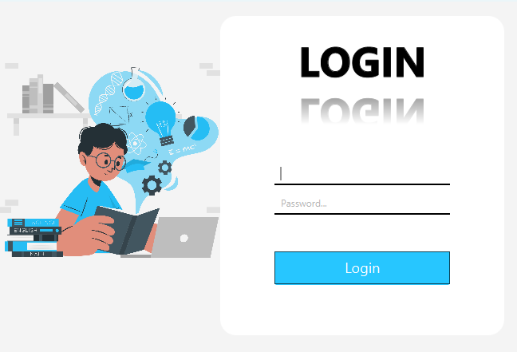
3. Views
Login Screen:

Slide 27
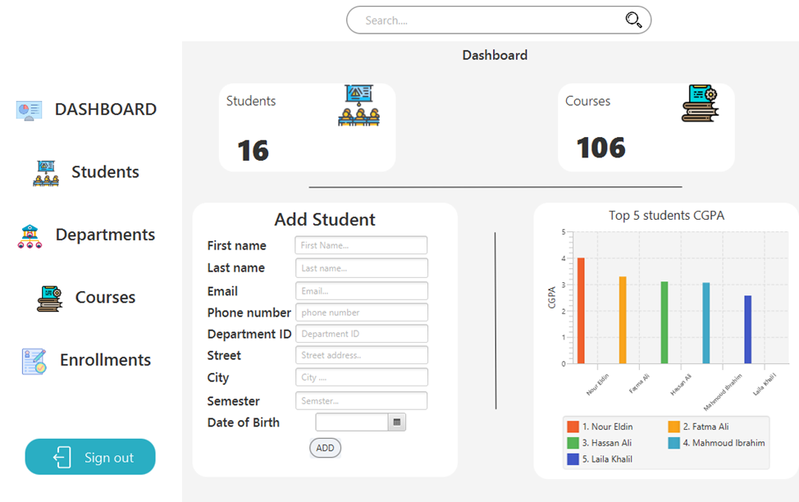
3. Views
Dashboard view:
View reports regarding the number of students and courses, and the top 5 students in the university.
Registering new student or adding a course.
Buttons to switch between different views or sign out.

Slide 28
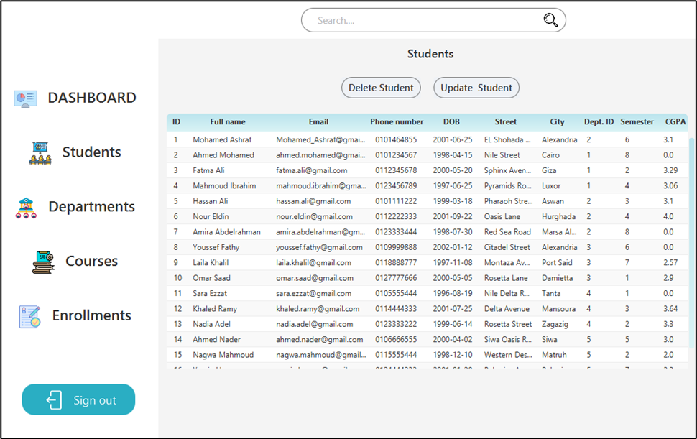
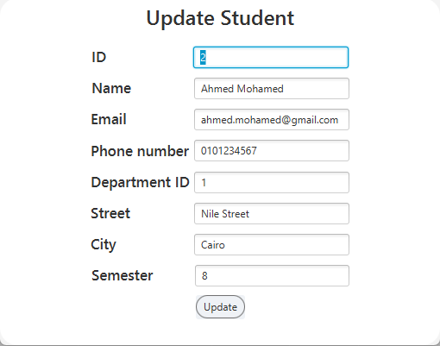
3. Views
Students view:
Showing all students in a table with all of their information.
Allows deletion or updating students.

Slide 29
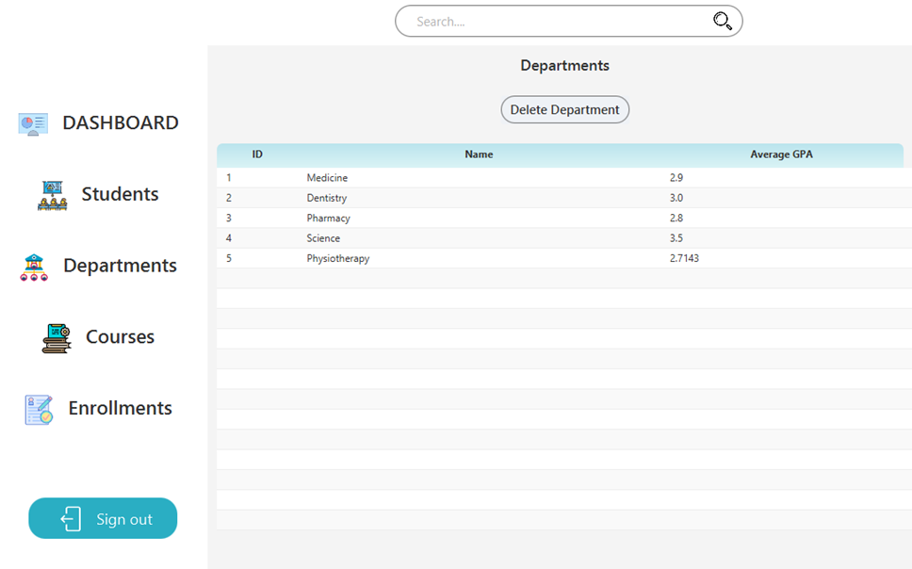
3. Views
Departments’ view:
show the department id, name and average GPA for each department.

Slide 30
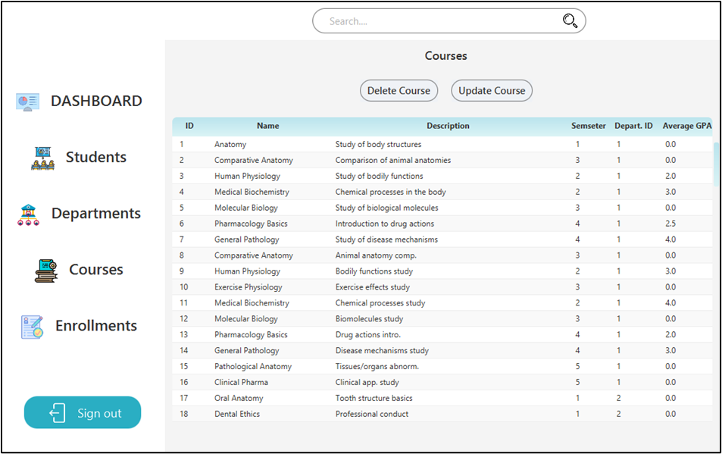
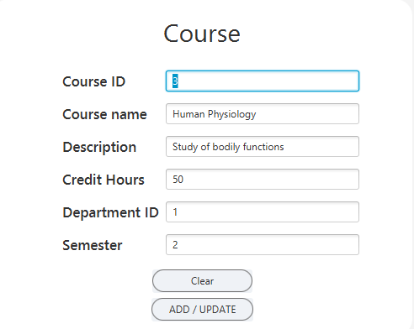
3. Views
Courses’ view:
View course id, name, description, department id the course related to, semester that the student should register to this course in, and average GPA for this course.
It allows deletion of the course with a warning for deletion of all of its enrollments.
It allows updating course information using update button.
Updating screen can be used also for adding a new course by clearing all the fields and enter the new course information.

Slide 31
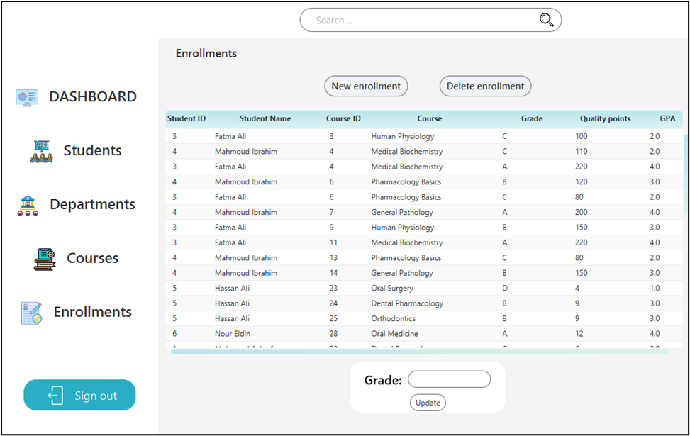
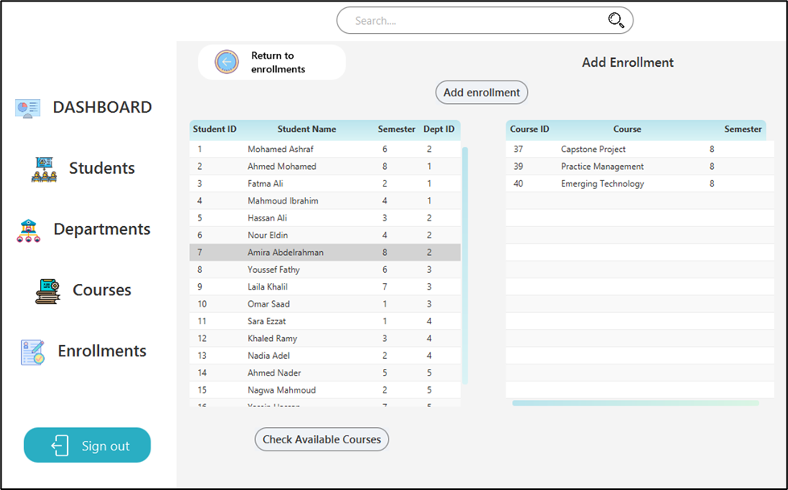
3. Views
Enrollment view:
View all enrollment with student id, course id, student name, course name, grade, quality points and GPA for each enrollment.
Allow updating grade for each enrollment and add points and GPA regarding to the grade.
Allow adding new enrollment by opening new scene and view the available courses for each student selected.

Slide 32
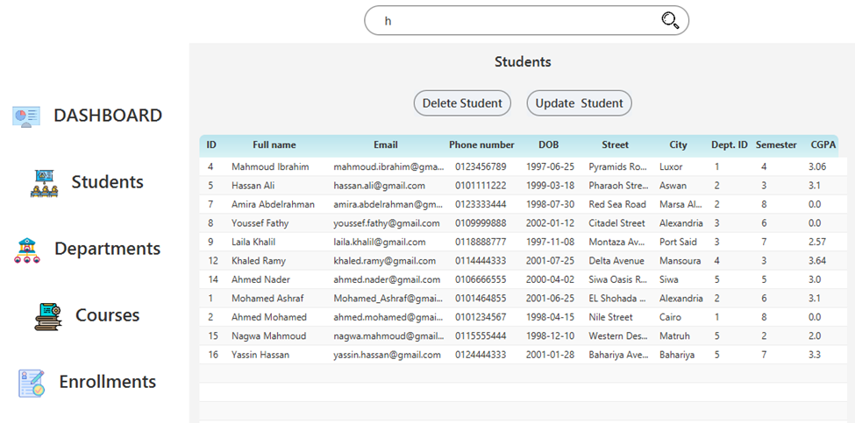
3. Views
Search:
Search box allows searching while in the students, departments, courses or enrollments scenes.

Slide 33
Thank You

